Slide 1
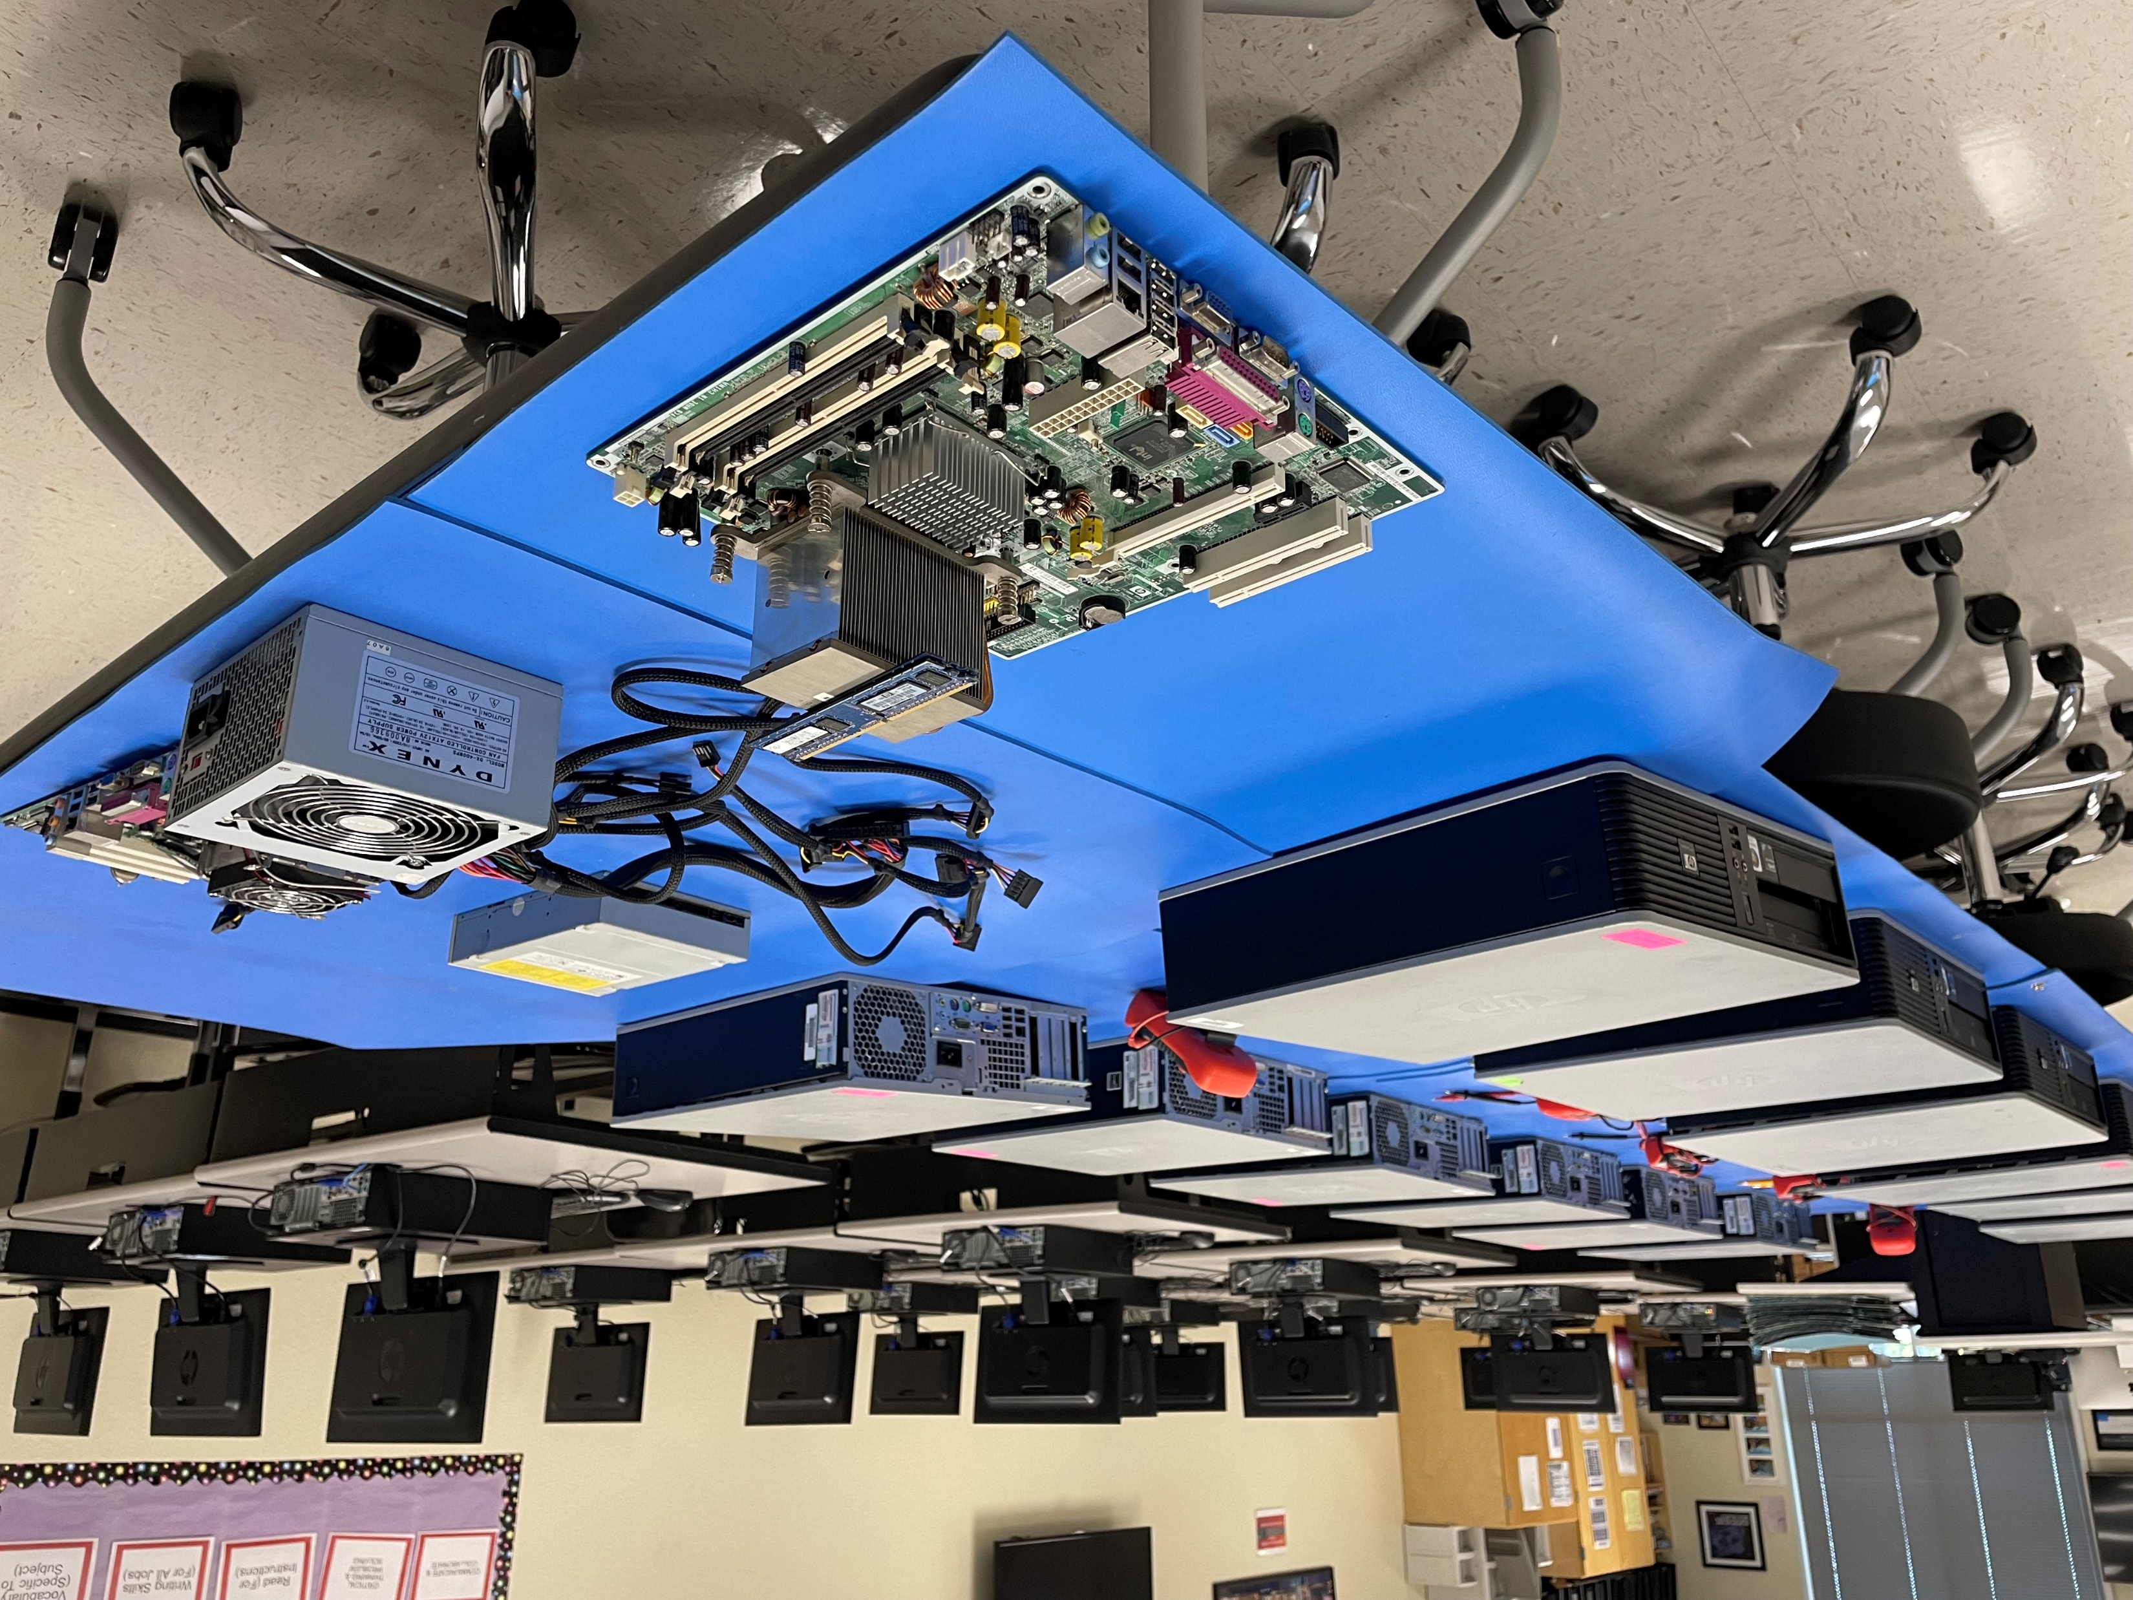
Information Technology Support and Services
Statewide Program of Study
Information Technology Career Cluster
The Information Technology (IT) Career Cluster focuses on building linkages in IT occupations for entry level, technical, and professional careers related to the design, development, support, and management of hardware, software, multimedia, and systems integration services.
The Information Technology Support and Services program of study explores the occupations and educational opportunities associated with administering, testing, and implementing computer databases and applying knowledge of database management systems. This program of study may also include analyzing user requirements and problems to automate or improve existing systems and review computer system capabilities. This program of study may also include exploration into the research, design, or testing of computer or computer-related equipment for commercial, industrial, military, or scientific use.
Work-Based Learning and
Expanded Learning Opportunities
Secondary Courses for High School Credit
1 Principles of Information Technology
2 Computer Maintenance
3 IT Troubleshooting
4 Practicum in Information Technology
Exploration Activities | Work-Based Learning Activities
Job shadow a database administrator or computer hardware engineer | Earn an IT certification
Industry-Based Certifications
Google IT Support Professional Certificate
Postsecondary Opportunities
Associates Degrees
Computer and Information Sciences, General
Computer and Information Systems Security/ Information Assurance
Information Technology
Computer Systems Networking and Telecommunications
Bachelor’s Degrees
Computer and Information Sciences, General
Computer and Information Systems Security /Information Assurance
Computer Engineering, General
Computer Systems Networking and Telecommunications
Master’s, Doctoral, and Professional Degrees
Computer and Information Sciences, General
Computer Systems Analysis/ Analyst
Computer Engineering, General
Information Technology
SMHS Information Tech Lab
Aligned Occupations
Occupations | Median Wage | Annual Openings | % Growth
Database Administrator | $83,075 | 1,063 | 19%
Computer Hardware Engineer | $111,738 | 343 | 24%
Computer System Analyst and Support | $87,568 | 5,937 | 29%
Successful completion of the Information Technology Support and Services program of study will fulfill requirements of the Business and Industry endorsement or STEM endorsement if the math and science requirements are met.
Revised – August 2022

Slide 2
Information Technology Support and Services Course Information
COURSE NAME | SERVICE ID | PREREQUISITES | COREQUISITES
Principles of Information Technology | 13027200 (1 credit) 6711 | None | None
Computer Maintenance | 13027300 (1 credit) 6712 | Principles of Information Technology | None
IT Troubleshooting | N1302815 (1 credit) TBD | Computer Maintenance | None
Practicum in Information Technology | 13028000 (2 credits) TBD | A minimum of two high school Information Technology (IT) courses | None
FOR ADDITIONAL INFORMATION ON THE INFORMATION TECHNOLOGY CAREER CLUSTER,
PLEASE CONTACT: CJ Odam, SMCISD CTE Coordinator cj.odam@smcisd.net
San Marcos CISD does not discriminate on the basis of race, color, national origin, sex, disability or age in its programs or activities and provides equal access to the Boy Scouts and other designated youth groups. The following person has been designated to handle inquiries regarding the nondiscrimination policies: Stephanie Munoz ; 631 Mill St, San Marcos, TX 78666 ; 512-393-6700 ; stephanie.munoz@smcisd.net
Further nondiscrimination information can be found at smcisd.net/cte

